Slide 1
Machine Learning CA1 26 November 2023
Zygimantas Jakubauskas -sba22342
Miroslava Slavikova - sba22382

Slide 2

Key Steps of the Project
Selection of the Data set
Exploratory data analysis
Data preparation
Machine learning models
Timeline
Conclusion

Slide 3
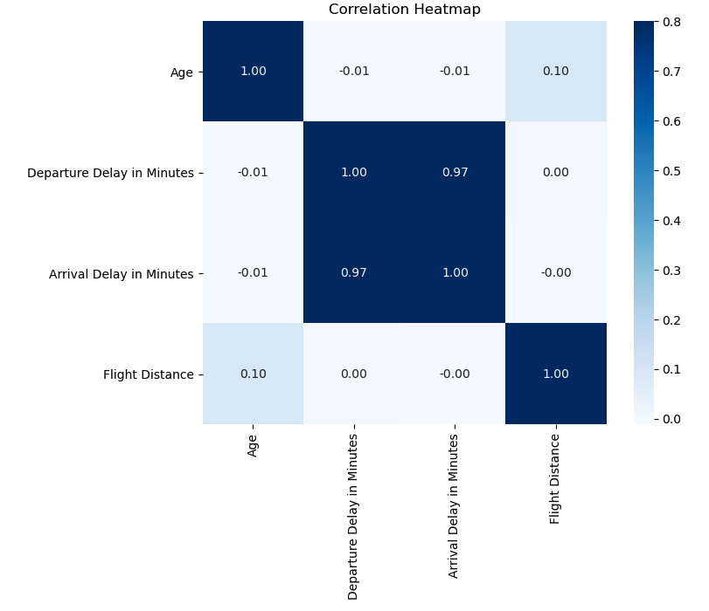
Correlation Heatmap Strong relationship between the "Arrival Delay in Minutes" and "Departure Delay in Minutes“ [by Miroslava]

Slide 4
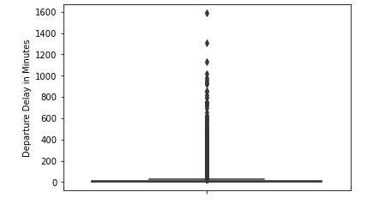
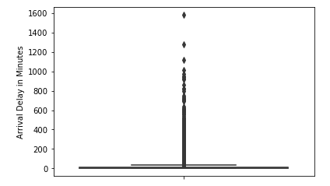
Exploratory Data Analysis using boxplots [by Zygimantas]

Slide 5
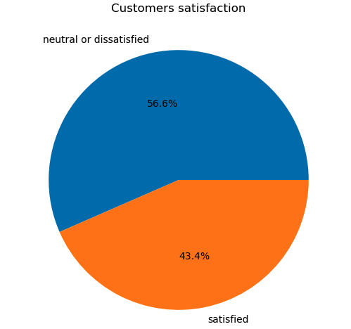
Data Preparation Pie chart displays distribution of “satisfaction” value [by Zygimantas]

Slide 6
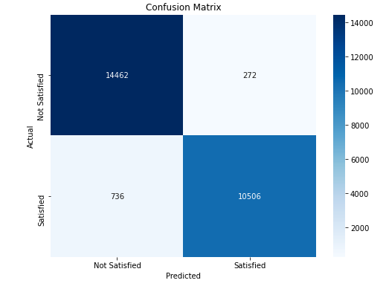
Confusion Matrix – Random Forest model Best performing at 0.2 test size [by Zygimantas]

Slide 7
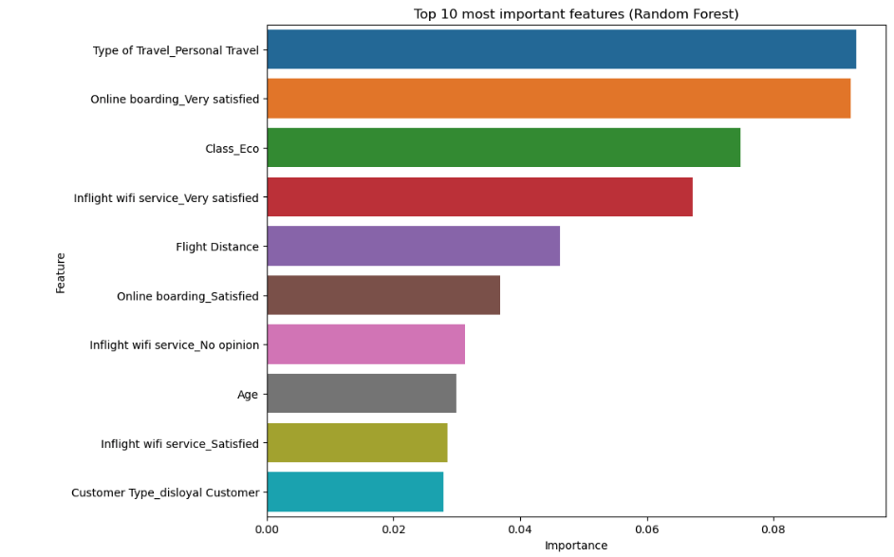
Top 10 most important features using Random Forest model [by Miroslava]

Slide 8
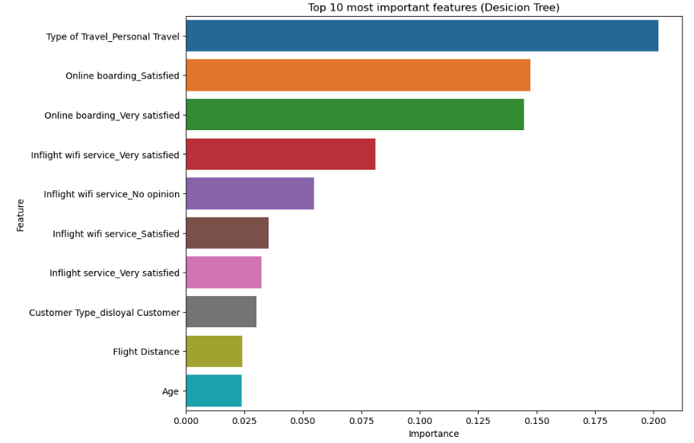
Top 10 most important features using Decision Tree model [by Miroslava]

Slide 9
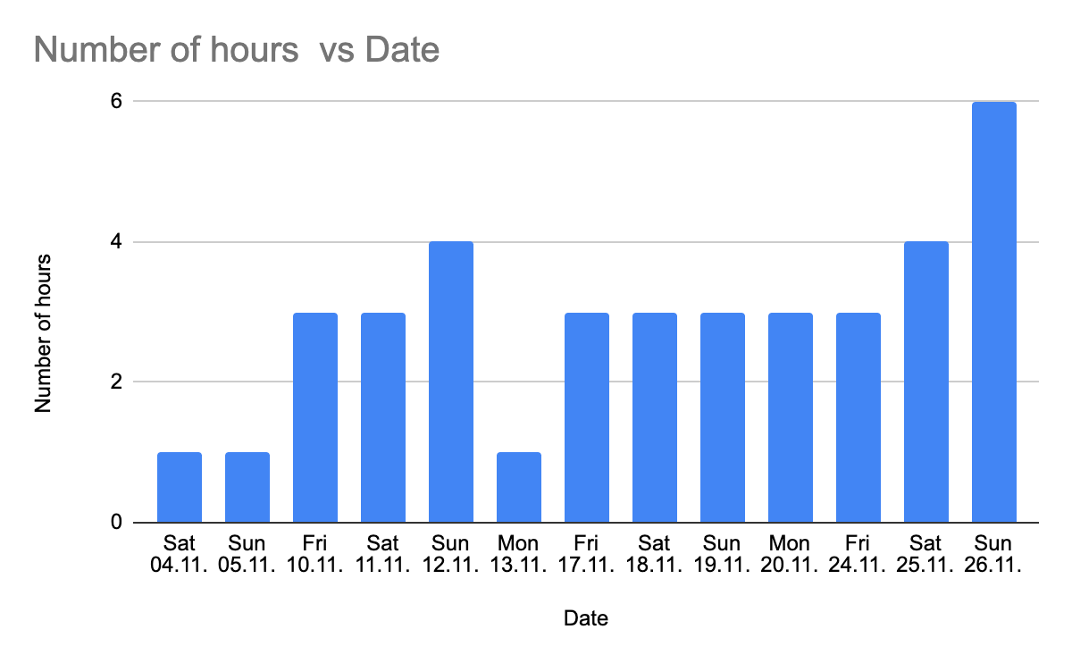
Time Spent on the Project - Miroslava

Slide 10
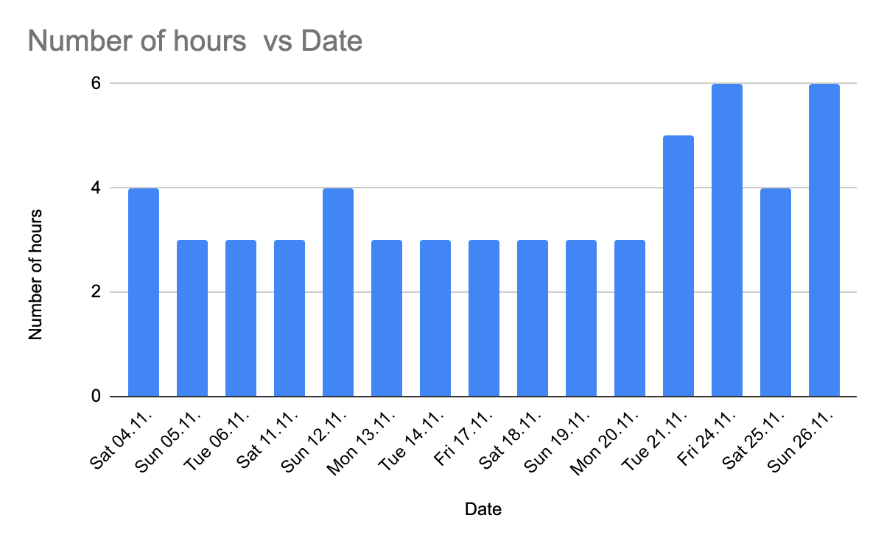
Time Spent on the Project - Zygimantas

Slide 11
Slide Title
Conclusion
Good teamwork can enhance the project outcome:
Identifying the member’s strengths improves productivity
Sharing ideas boosts creativity
Learning from each other’s experiences improves knowledge
Rectifying problems together strengthen problem solving skills

Slide 12
Thank you..

